Slide 1
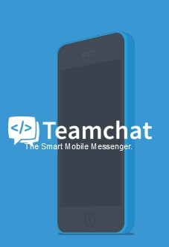

Slide 2

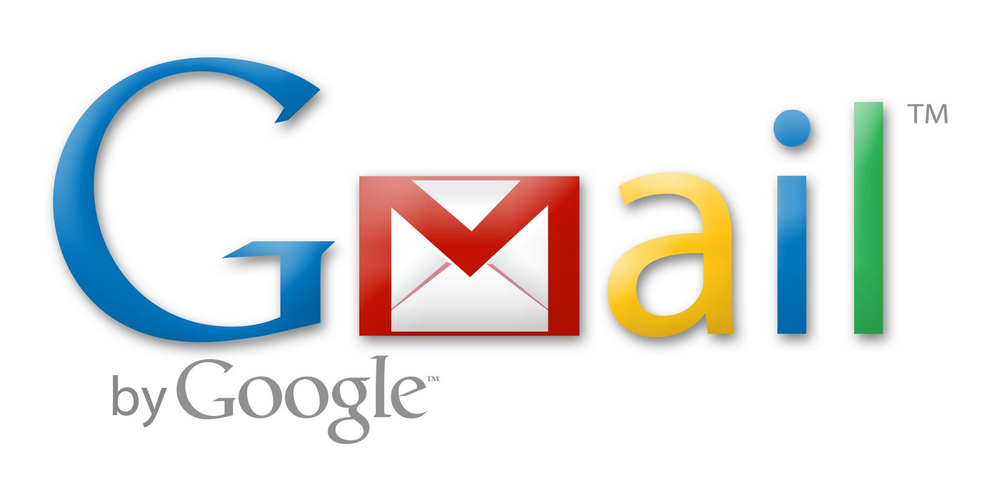
Integrating Gmail with Teamchat
Integrating Gmail with teamchat will help user to view their unread mails and also reply to the mails directly through teamchat.

Slide 3

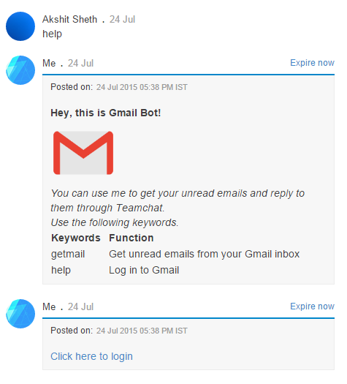
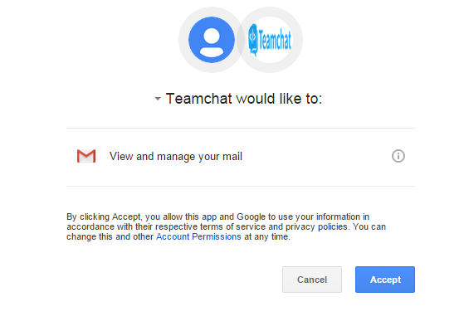
Help keyword initiates the bot as well as gives
user the login link which authorizes teamchat to
access data from users gmail account.

Slide 4
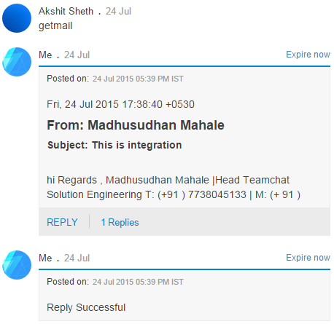
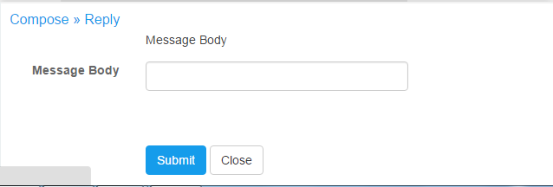
getmail is the keyword to get all the unread
emails directly through teamchat.
User can also directly reply to any notified
email directly on teamchat.

Slide 5
